Slide 1

Cardiovascular Emergencies
CHAPTER 17

Slide 2
National EMS Education Standard Competencies (1 of 5)
Pathophysiology
Applies fundamental knowledge of the pathophysiology of respiration and perfusion to patient assessment and management.
Notes:
National EMS Education Standard Competencies
Pathophysiology
Applies fundamental knowledge of the pathophysiology of respiration and perfusion to patient assessment and management.

Slide 3
National EMS Education Standard Competencies (2 of 5)
Medicine
Applies fundamental knowledge to provide basic emergency care and transportation based on assessment findings for an acutely ill patient.
Notes:
National EMS Education Standard Competencies
Medicine
Applies fundamental knowledge to provide basic emergency care and transportation based on assessment findings for an acutely ill patient.

Slide 4
National EMS Education Standard Competencies (3 of 5)
Cardiovascular
Anatomy, signs, symptoms, and management of
  Chest pain
  Cardiac arrest
Notes:
National EMS Education Standard Competencies
Cardiovascular
Anatomy, signs, symptoms, and management of
• Chest pain
• Cardiac arrest

Slide 5
National EMS Education Standard Competencies (4 of 5)
Anatomy, physiology, pathophysiology, assessment, and management of
  Acute coronary syndrome
    Angina pectoris
    Myocardial infarction
  Aortic aneurysm/dissection
Notes:
National EMS Education Standard Competencies
Anatomy, physiology, pathophysiology, assessment, and management of
Acute coronary syndrome
Angina pectoris
Myocardial infarction
Aortic aneurysm/dissection

Slide 6
National EMS Education Standard Competencies (5 of 5)
Anatomy, physiology, pathophysiology, assessment, and management of (cont’d)
  Thromboembolism
  Heart failure
  Hypertensive emergencies
Notes:
National EMS Education Standard Competencies
• Thromboembolism
• Heart failure
• Hypertensive emergencies

Slide 7
Introduction (1 of 3)
Cardiovascular disease has been the leading killer of Americans since 1900.
Accounts for 1 of every 3 deaths
Notes:
Lecture Outline
I. Introduction
A. Cardiovascular disease accounts for about 1 of every 3 deaths.

Slide 8
Introduction (2 of 3)
EMS can help reduce deaths by:
  Encouraging healthy lifestyle
  Early access to medical care
  More CPR training of laypeople
  Increased use of evolving technology in dispatch and cardiac arrest response
Notes:
Lecture Outline
B. EMS can help reduce deaths by providing the following services:
1. Encouragement of people to follow a healthy lifestyle
2. Early access to medical care
3. More CPR training of laypeople
4. Increased use of evolving technology in dispatch and cardiac arrest response

Slide 9
Introduction (3 of 3)
EMS can help reduce deaths by (cont’d):
  Public access to defibrillation devices
  Recognizing need for advanced life support (ALS)
  The use of cardiac specialty centers when they are available
Notes:
Lecture Outline
5. Public access to defibrillation devices
6. Recognition of the need for ALS
7. The use of cardiac specialty centers when they are available

Slide 10
Anatomy and Physiology (1 of 17)
Heart’s job is to pump blood to supply oxygen-enriched red blood cells to tissues.
Divided into left and right sides
Upper chambers (atria) receive incoming blood.
Lower chambers (ventricles) pump outgoing blood.
Notes:
Lecture Outline
II. Anatomy and Physiology
A. The heart’s job is to pump blood to supply oxygen-enriched red blood cells to the tissues of the body.
1. The heart is divided down the middle into left and right sides, each with an upper chamber (atrium) to receive incoming blood and a lower chamber (ventricle) to pump outgoing blood.

Slide 11
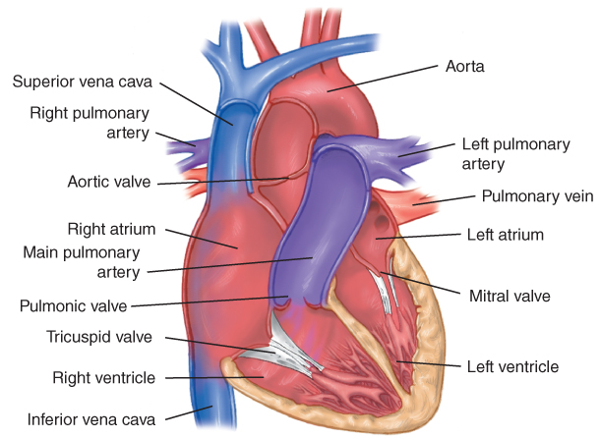
Anatomy and Physiology (2 of 17)
FIGURE 17-1 The heart is a four-chambered muscle that pumps blood to all parts of the body.
© Jones & Bartlett Learning.
Notes:
The figure on this slide illustrates the heart.

Slide 12
Anatomy and Physiology (3 of 17)
One-way valves keep blood flowing in the proper direction.
The aorta, the body’s main artery, receives blood ejected from left ventricle.
Notes:
Lecture Outline
2. Blood leaves each of the four chambers of the heart through one-way valves, which keep the blood moving through the circulatory system in the proper direction.
3. The aorta, the body’s main artery, receives blood ejected from the left ventricle and delivers it to all other arteries that supply the body’s tissues.

Slide 13
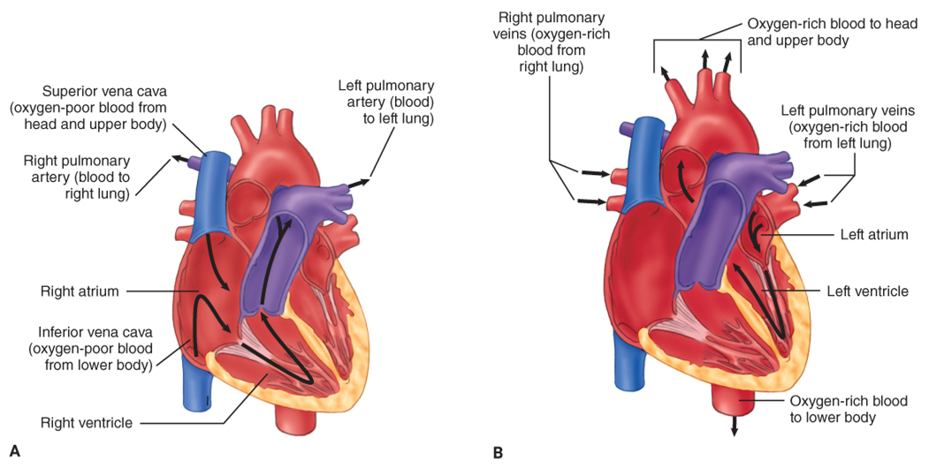
Anatomy and Physiology (4 of 17)
FIGURE 17-2 A. The right side of the heart receives oxygen-poor blood from the venous circulation. B. The left side of the heart receives oxygen-rich blood from the lungs through the pulmonary veins.
A, B: © Jones & Bartlett Learning.
Notes:
This figures on this slide illustrate how blood circulates through the heart. A. The right side of the heart receives oxygen-poor blood from the venous circulation. B. The left side of the heart receives oxygen-rich blood from the lungs through the pulmonary veins.

Slide 14
Anatomy and Physiology (5 of 17)
Heart’s electrical system controls heart rate and coordinates atria and ventricles.
Electrical impulses start at the SA node.
  Passes from the atria to the ventricles
Automaticity allows spontaneous contraction without a stimulus from a nerve source.
Notes:
Lecture Outline
B. The heart’s electrical system controls heart rate and coordinates the work of the atria and ventricles.
1. The heart generates its own electrical impulse, starting at the sinus node.
2. The impulse passes from the atria to the ventricles.
C. Automaticity allows spontaneous contraction without a stimulus from a nerve source.
1. As long as impulses come from the sinoatrial node, the other myocardial cells will contract when the impulse reaches them.
2. If no impulse arrives, however, the other myocardial cells are capable of creating their own impulses and stimulating a contraction.

Slide 15
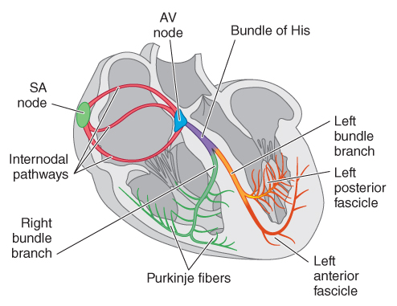
Anatomy and Physiology (6 of 17)
Electrical conduction system of the heart
FIGURE 17-3 The electrical conduction system of the heart controls most aspects of heart rate and enables the four chambers to work together.
AV = atrioventricular; SA = sinoatrial.
© Jones & Bartlett Learning
Notes:
The figure on this slide illustrates the electrical conduction system of the heart.

Slide 16
Anatomy and Physiology (7 of 17)
Autonomic nervous system (ANS) controls involuntary activities.
The ANS has two parts:
  Sympathetic nervous system
  Parasympathetic nervous system
Notes:
Lecture Outline
D. The autonomic nervous system (ANS) controls involuntary activities of the body.
1. The ANS has two parts, which normally balance one another.
a. Sympathetic nervous system
b. Parasympathetic nervous system

Slide 17
Anatomy and Physiology (8 of 17)
The myocardium must have a continuous supply of oxygen and nutrients to pump blood.
Cardiac output is increased by increasing the heart rate or stroke volume.
In the normal heart, increased blood is delivered to the myocardium by dilating the coronary arteries.
Notes:
Lecture Outline
E. The myocardium must have a continuous supply of oxygen and nutrients to pump blood.
1. Cardiac output is increased by increasing the heart rate or stroke volume.
2. In the normal heart, the increased oxygen demand of the myocardium itself is accomplished by increasing the amount of blood delivered to myocardium by dilating the coronary arteries.

Slide 18
Anatomy and Physiology (9 of 17)
Coronary arteries are blood vessels that supply blood to heart muscle.
Coronary arteries start at the first part of the aorta:
  Right coronary artery
  Left coronary artery
Notes:
Lecture Outline
F. The coronary arteries are blood vessels that supply blood to heart muscle.
1. They start at the first part of the aorta, just above the aortic valve.
2. The right coronary artery supplies blood to the right atrium and right ventricle and, in most people, the inferior wall of the left ventricle.
3. The left coronary artery supplies blood to the left atrium and left ventricle and divides into two major branches just a short distance from the aorta.

Slide 19
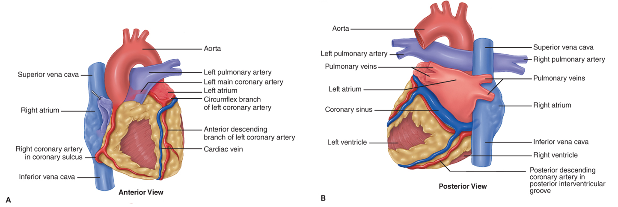
Anatomy and Physiology (10 of 17)
FIGURE 17-4 Blood flow to the heart. A. Coronary arteries (anterior view). B. Coronary arteries (posterior view).
A, B: © Jones & Bartlett Learning.
Notes:
The figure on this slide illustrates how the coronary arteries carry the blood supply to the heart.

Slide 20
Anatomy and Physiology (11 of 17)
Arteries supply oxygen to different parts of the body:
  Right and left carotid
  Right and left subclavian
  Brachial
  Radial and ulnar
  Right and left iliac
  Right and left femoral
  Anterior and posterior tibial and peroneal
Notes:
Lecture Outline
G. The arteries supply oxygenated blood to different parts of the body.
1. The right and left carotid arteries supply the head and brain.
2. The right and left subclavian arteries supply the upper extremities.
3. The brachial artery supplies the arms.
4. The radial and ulnar arteries supply the lower arms and hands.
5. The right and left iliac arteries supply the groin, pelvis, and legs.
6. The right and left femoral arteries supply the legs.
7. The anterior and posterior tibial and peroneal arteries supply the lower legs and feet.

Slide 21
Anatomy and Physiology (12 of 17)
Arterioles and capillaries are smaller vessels.
  Capillaries connect arterioles to venules.
Venules are the smallest branches of the veins.
  Venae cavae return deoxygenated blood to the heart.
Notes:
Lecture Outline
H. The arterioles and capillaries are smaller vessels that receive blood from the arteries.
1. Capillaries are one-cell thick.
a. Exchange nutrients and oxygen for waste at the cellular level
b. Connect arterioles to venules
I. The venules and veins receive blood from the capillaries.
1. Venules are the smallest branches of the veins.
2. Venae cavae return oxygen-poor blood to the heart.
a. Superior vena cava carries blood from the head and the arms back to the right atrium.
b. Inferior vena cava carries blood from the abdomen, kidneys, and legs back to the right atrium.

Slide 22
Anatomy and Physiology (13 of 17)
Blood consists of:
  Red blood cells, which carry oxygen
  White blood cells, which fight infection
  Platelets, which help blood to clot
  Plasma, which is the fluid cells float in
Notes:
Lecture Outline
J. Blood consists of several types of cells and fluid.
1. Red blood cells carry oxygen and remove carbon dioxide.
2. White blood cells fight infection.
3. Platelets help blood to clot.
4. Plasma is the fluid that cells float in.

Slide 23
Anatomy and Physiology (14 of 17)
Blood pressure is the force of circulating blood against artery walls.
  Systolic blood pressure
    The maximum pressure generated by left ventricle
  Diastolic blood pressure
    The pressure against artery walls while the left ventricle is at rest
Notes:
Lecture Outline
K. Blood pressure is the force of circulating blood against artery walls.
1. Systolic blood pressure is the maximum pressure generated in the arms and legs during the contraction of the left ventricle during the time period known as systole.
2. Diastolic blood pressure is the pressure against artery walls while the left ventricle relaxes.

Slide 24
Anatomy and Physiology (15 of 17)
A pulse is felt when blood passes through an artery during systole.
  Peripheral pulses felt in the extremities
  Central pulses felt near the body’s trunk
Notes:
Lecture Outline
L. A pulse is felt when blood passes through an artery during systole.
1. Peripheral pulses are felt in the extremities (eg, radial and posterior tibial).
2. Central pulses are felt near the trunk of the body (eg, femoral and carotid).

Slide 25
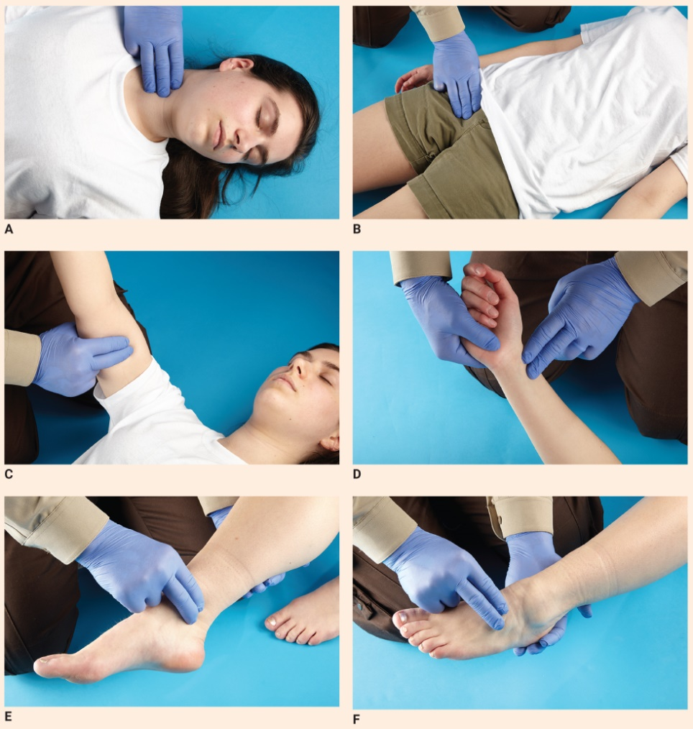
Anatomy and Physiology (16 of 17)
Carotid
Femoral
Brachial
Radial
Posterior tibial
Dorsalis pedis
FIGURE 17-7 Common pulse points. A. The carotid pulse is felt in the neck. B. The femoral pulse is felt in the groin area. C. The brachial pulse is felt on the inside of the upper arm. D. The radial pulse is felt on the thumb side of the wrist. E. The posterior tibial pulse is felt on the inside of the ankle. F. The dorsalis pedis pulse is felt on the top of the foot.
A-F: © Jones & Bartlett Learning.
Notes:
The figures on this slide demonstrate common pulse points. A. Carotid pulse. B. Femoral pulse. C. Brachial pulse. D. Radial pulse. E. Posterior tibial pulse. F. Dorsalis pedis pulse.

Slide 26
Anatomy and Physiology (17 of 17)
Cardiac output is the volume of blood that passes through the heart in 1 minute.
Perfusion is the constant flow of oxygenated blood to tissues.
If perfusion fails, cellular and eventually patient death occur.
Notes:
Lecture Outline
M. Cardiac output is defined as the volume of blood that passes through the heart in 1 minute.
1. Calculated by multiplying the heart rate by the volume of blood ejected with each contraction (stroke volume)
a. In the field, stroke volume can be roughly determined by the heart rate and the strength of a patient’s pulse.
N. Perfusion describes the constant flow of oxygenated blood to the tissues.
1. Good perfusion requires the following:
a. A well-functioning heart
b. An adequate volume of ”fluid” or blood
c. Blood vessels must be appropriately constricted to match the volume of blood available.
2. If perfusion fails, cellular death occurs, and, eventually, the patient will die.

Slide 27
Pathophysiology (1 of 22)
Chest pain usually stems from ischemia, which is decreased blood flow.
  Ischemic heart disease involves a decreased blood flow to one or more portions of the heart.
  If blood flow is not restored, the tissue dies.
Notes:
Lecture Outline
III. Pathophysiology
A. Heart-related chest pain usually stems from ischemia, which is decreased blood flow to the heart or inefficient supply of oxygen and nutrients.
1. Ischemic heart disease involves a decrease in blood flow to one or more portions of the heart muscle.
2. If the blood flow is not restored, the tissue dies.

Slide 28
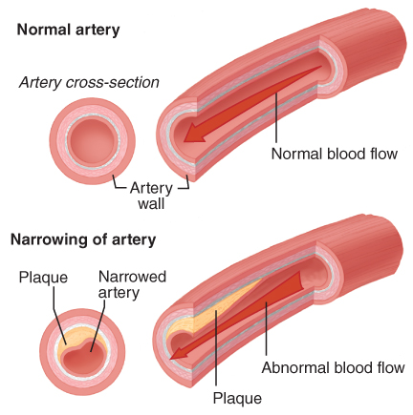
Pathophysiology (2 of 22)
Atherosclerosis is the buildup of calcium and cholesterol in the arteries.
FIGURE 17-8 In atherosclerosis, calcium and cholesterol
build up inside the walls of the coronary blood vessels,
causing an obstruction in blood flow to the heart.
© Jones & Bartlett Learning.
Notes:
Lecture Outline
B. Atherosclerosis is a disorder in which calcium and cholesterol build up and form a plaque inside the walls of blood vessels.
1. It can cause complete occlusion or blockage of a coronary artery and other arteries of the body.
2. Fatty material accumulates as a person ages, resulting in the narrowing of the lumen.
a. The inner wall of the artery becomes rough and brittle.
b. If a brittle plaque develops a crack (for unknown reasons), the ragged edge of the crack activates the blood-clotting system, resulting in a blood clot that will partially or completely block the lumen of the artery.

Slide 29
Pathophysiology (3 of 22)
A thromboembolism is a blood clot floating through blood vessels.
If a clot lodges in a coronary artery, acute myocardial infarction (AMI) results.
Notes:
Lecture Outline
3. A thromboembolism is a blood clot that floats through the blood vessels.
a. If it reaches an area too narrow for it to pass, it stops and blocks blood flow at that point.
b. Tissues downstream from the blood clot will suffer from hypoxia.
c. If too much time passes before blood flow is resumed, the tissues will die.
d. This sequence of events is known as acute myocardial infarction (AMI), a classic heart attack.
e. The death of heart muscle can severely diminish the heart’s ability to pump.

Slide 30
Pathophysiology (4 of 22)
Coronary artery disease is the leading cause of death in the United States.
Controllable AMI risk factors:
  Cigarette smoking, high blood pressure, high cholesterol, diabetes, lack of exercise, and obesity
Uncontrollable AMI risk factors:
  Older age, family history, atherosclerotic coronary artery disease, race, ethnicity, and being male
Notes:
Lecture Outline
4. In the United States, coronary artery disease is the number one cause of death for men and women.
a. The peak incidence of heart disease is between 45 and 64 years, but it can strike in individuals ranging from their teens to their 90s.
5. Risk factors place a person at higher risk for an AMI.
a. Major controllable risk factors:
i. Cigarette smoking
ii. High blood pressure
iii. Elevated cholesterol level
iv. Diabetes
v. Lack of exercise
vi. Obesity
b. Major uncontrollable risk factors:
i. Older age
ii. Family history
iii. Race
iv. Ethnicity
v. Male sex

Slide 31
Pathophysiology (5 of 22)
Acute coronary syndrome (ACS) is caused by myocardial ischemia.
  Angina pectoris
  Acute myocardial infarction (AMI)
Notes:
Lecture Outline
C. Acute coronary syndrome (ACS) describes a group of symptoms caused by myocardial ischemia.
1. This includes temporary myocardial ischemia, resulting in angina pectoris or a more serious condition, an AMI.

Slide 32
Pathophysiology (6 of 22)
Angina pectoris occurs when the heart’s need for oxygen exceeds supply.
  Crushing or squeezing pain
  Does not usually lead to death or permanent heart damage
  Should be taken as a serious warning sign
Notes:
Lecture Outline
D. Angina pectoris occurs when the heart’s need for oxygen exceeds the available supply, usually during physical or emotional stress.
1. It can result from a spasm of an artery but is most often a symptom of atherosclerotic coronary artery disease.
a. May be triggered by large meal or sudden fear
b. When increased oxygen demand goes away, the pain typically goes away
2. Angina pain is commonly described as crushing, squeezing, or “like somebody is standing on my chest.”
a. Usually felt in the midportion of the chest, under the sternum
b. Can radiate to the jaw, arms (frequently the left arm), midback, or epigastrum
c. Usually lasts from 3 to 8 minutes but rarely longer than 15 minutes
d. May be associated with shortness of breath, nausea, or sweating
e. Usually disappears promptly with rest, supplemental oxygen, or nitroglycerin (NTG)
3. Although angina does not usually lead to death or permanent heart damage, it is a warning sign that should be taken seriously.

Slide 33
Pathophysiology (7 of 22)
Unstable angina
  Occurs in the absence of a significant increase in oxygen demand
Stable angina
  Occurs in response to exercise or activity that increases demand on the heart muscle
Treat angina patients like AMI patients.
Notes:
Lecture Outline
4. Unstable angina is characterized by pain or discomfort that occurs in the absence of a significant increase in myocardial oxygen demand.
5. Stable angina is characterized by pain in the chest of coronary origin that occurs in response of to exercise or some activity that increases the demand on the heart muscle that is beyond the heart’s capacity to increase it own blood flow.
6. Patients experiencing chest pain or discomfort should always be treated as if they are having an AMI.

Slide 34
Pathophysiology (8 of 22)
AMI pain signals actual death of cells in heart muscle.
  Once dead, cells cannot be revived.
  “Clot-busting” (thrombolytic) drugs or angioplasty within the first few hours prevents damage.
  Immediate transport is essential.
Notes:
Lecture Outline
E. The pain of AMI signals the actual death of cells in the area of the heart where blood flow is obstructed.
1. Once dead, the cells cannot be revived.
a. They will turn to scar tissue and become a burden to the beating heart.
b. About 30 minutes after blood flow is cut off, some heart muscles begin to die.
c. After about 2 hours, as many as half of the cells in the area may be dead.
d. After 4 to 6 hours, more than 90% of the cells will be dead.
2. Opening the coronary artery with either “clot-busting” (thrombolytic) drugs or angioplasty (mechanical clearing of the artery) can prevent permanent damage if it is done within the first few hours after the onset of symptoms.
3. Immediate transport is essential.

Slide 35
Pathophysiology (9 of 22)
Signs and symptoms of AMI
  Weakness, nausea, sweating
  Chest pain, discomfort, or pressure
  Lower jaw, arm, back, abdomen, or neck pain
  Irregular heartbeat and syncope (fainting)
  Shortness of breath (dyspnea)
  Nausea/vomiting
  Pink, frothy sputum
  Sudden death
Notes:
Lecture Outline
4. It is more likely to occur in the left ventricle.
5. Signs and symptoms of AMI include the following:
a. Sudden onset of weakness, nausea, and sweating
b. Chest pain, discomfort, or pressure that is often crushing or squeezing that does not change with each breath
c. Pain, discomfort, or pressure in the lower jaw, arms, back, abdomen, or neck
d. Irregular heartbeat and syncope
e. Shortness of breath
f. Nausea/vomiting
g. Pink, frothy sputum
h. Sudden death

Slide 36
Pathophysiology (10 of 22)
AMI pain differs from angina pain.
  Not always due to exertion
  Lasts 30 minutes to several hours
  Not always relieved by rest or nitroglycerin
AMI patients may not realize they are experiencing a heart attack.
Notes:
Lecture Outline
6. The pain of AMI differs from the pain of angina in three ways:
a. It may or may not be caused by exertion and can occur at any time, sometimes when a person is sitting quietly or even sleeping.
b. It does not resolve in a few minutes; rather, it can last between 30 minutes and several hours.
c. It may or may not be relieved by rest or nitroglycerin.
7. Not all patients who are having an AMI experience pain or recognize when it occurs.
a. When called to a scene where the chief complaint is chest pain, complete a thorough assessment, no matter what the patient says.

Slide 37
Pathophysiology (11 of 22)
AMI and cardiac compromise physical findings:
  Fear, nausea, poor circulation
  Faster, irregular, or bradycardic pulse
  Decreased, normal, or elevated blood pressure
  Normal or rapid and labored respirations
  Patients express feelings of impending doom.
Notes:
Lecture Outline
8. Physical findings of AMI and cardiac compromise include the following:
a. General appearance: fear, nausea, poor circulation
b. Pulse: faster, irregular, or bradycardic
c. Blood pressure: decreased, normal, or elevated
d. Respirations: normal or rapid and labored
e. Mental status: feelings of impending doom

Slide 38
Pathophysiology (12 of 22)
Three serious consequences of AMI:
  Sudden death
  Cardiogenic shock
  Congestive heart failure (CHF)
Notes:
Lecture Outline
9. An AMI can have three serious consequences:
a. Sudden death
b. Cardiogenic shock
c. Congestive heart failure

Slide 39
Pathophysiology (13 of 22)
Dysrhythmia: heart rhythm abnormalities
  Premature ventricular contractions
  Tachycardia
  Bradycardia
  Ventricular tachycardia
  Ventricular fibrillation
Notes:
Lecture Outline
F. Dysrhythmia describes an abnormality of the heart rhythm.
1. Premature ventricular contractions are extra beats in a damaged ventricle.
a. Harmless and common among healthy as well as sick people
2. Tachycardia describes rapid beating of the heart, at 100 beats/min or more.
3. Bradycardia describes unusually slow beating of the heart, at 60 beats/min or less.
4. Ventricular tachycardia describes a very rapid heart rhythm, at 150 to 200 beats/min.
a. May deteriorate into ventricular fibrillation
5. Ventricular fibrillation describes the disorganized, ineffective quivering of ventricles.
a. No blood is pumped through the body, and the patient usually becomes unconscious within seconds.
b. Defibrillation may convert this arrhythmia.

Slide 40
Pathophysiology (14 of 22)
Defibrillation restores cardiac rhythms.
  Can save lives
  Initiate CPR until a defibrillator is available.
Asystole
  Absence of all heart electrical activity
  Reflects a long period of ischemia
  Nearly all patients will die.
Notes:
Lecture Outline
G. Defibrillation is the process of shocking the heart with a specialized electrical current to restore normal cardiac rhythms.
1. It can save lives if shocks are delivered within the first few minutes of sudden death.
2. CPR must be initiated until a defibrillator is available.
3. Chances of survival diminish approximately 7% to 10% each minute until defibrillation is accomplished.
H. Asystole is the absence of all heart electrical activity.
1. It usually reflects a long period of ischemia.
2. Nearly all patients with asystole will die.

Slide 41
Pathophysiology (15 of 22)
Cardiogenic shock
  Often caused by heart attack
  Heart lacks power to force enough blood through circulatory system.
  Inadequate oxygen to body tissues causes organs to malfunction.
  Recognize shock in its early stages.
Notes:
Lecture Outline
I. Shock occurs when body tissues do not get enough oxygen, causing body organs to malfunction.
1. Cardiogenic shock is often caused by a heart attack.
2. The heart lacks the power to force enough blood through the circulatory system.
3. It is more common in an AMI affecting the inferior and posterior regions of the left ventricle.
4. It is important to recognize shock in its early stages.

Slide 42
Pathophysiology (16 of 22)
Congestive heart failure
  Often occurs a few days following heart attack
  Increased heart rate and enlargement of left ventricle no longer make up for decreased heart function
  Lungs become congested with fluid.
  May cause dependent edema.
Notes:
Lecture Outline
J. Congestive heart failure (CHF) often occurs within the first few days after a myocardial infarction.
1. CHF develops when increased heart rate and enlargement of the left ventricle no longer make up for decreased heart.
2. It is called “congestive” because lungs become congested with fluid (pulmonary edema) once the heart fails to pump effectively.
a. Occurs suddenly or slowly over months
b. In acute-onset CHF, severe pulmonary edema is accompanied by pink, frothy sputum and severe dyspnea.
3. With right side heart failure, blood backs up in the vena cavae, causing fluid to collect in other parts of the body (dependent edema), such as in the feet and legs.
a. Right heart failure can result in an inadequate supple of blood to the left ventricle, resulting in a drop in the systemic blood pressure.
b. Patients may present with signs of both left- and right-side heart failure because left-side failure often leads to right-side failure.

Slide 43
Pathophysiology (17 of 22)
Hypertensive emergencies
  Systolic pressure greater than 180 mm Hg
  Common symptoms
    Sudden, severe headache
    Strong, bounding pulse
    Ringing in the ears
Notes:
Lecture Outline
K. Hypertensive emergencies involve any systolic blood pressure greater than 180 mm Hg or a rapid increase in the systolic pressure.
1. Sudden, severe headache is a common sign.
2. Other symptoms:
a. Strong, bounding pulse and ringing in the ears

Slide 44
Pathophysiology (18 of 22)
Hypertensive emergencies (cont’d)
  Common symptoms
    Nausea and vomiting
    Dizziness
    Warm skin (dry or moist)
    Nosebleed
    Altered mental status
    Sudden pulmonary edema
Notes:
Lecture Outline
b. Nausea and vomiting
c. Dizziness
d. Warm skin (dry or moist)
e. Nosebleed
f. Altered mental status
g. Sudden development of pulmonary edema

Slide 45
Pathophysiology (19 of 22)
Hypertensive emergencies (cont’d)
  If untreated, can lead to stroke or dissecting aortic aneurysm.
  Transport patients quickly and safely.
  Consider ALS assistance.
Notes:
Lecture Outline
3. Untreated hypertensive emergencies can lead to stroke or dissecting aortic aneurysm.
4. Transport patients to the hospital as quickly and safely as possible.
a. Consider ALS assistance, depending on transport distance and time

Slide 46
Pathophysiology (20 of 22)
Aortic aneurysm is weakness in the wall of the aorta.
  Susceptible to rupture
  Dissecting aneurysm occurs when inner layers of aorta become separated.
  Primary cause: uncontrolled hypertension
Notes:
Lecture Outline
L. Aortic aneurysm describes a weakness in the wall of the aorta.
1. The aorta dilates at the weakened area, which makes it susceptible to rupture.
a. If it ruptures, blood loss will cause the patient to die almost immediately.
2. Uncontrolled hypertension is the primary cause of dissecting aortic aneurysms.
3. A dissecting aneurysm occurs when inner layers of the aorta become separated, allowing blood to flow at high pressure between the layers.

Slide 47
Pathophysiology (21 of 22)
Aortic aneurysm (cont’d)
  Signs and symptoms
    Very sudden chest pain
    Comes on full force
    Different blood pressures
  May be difficult to tell the difference between a dissecting aneurysm and AMI
  Transport patients quickly and safely.
Notes:
Lecture Outline
4. Signs and symptoms include very sudden chest pain located in the anterior part of the chest or in the back between the shoulder blades.
5. May be difficult to differentiate the pain of a dissecting aortic aneurysm from that of an AMI.
6. Transport patients to the hospital as quickly and safely as possible.

Slide 48
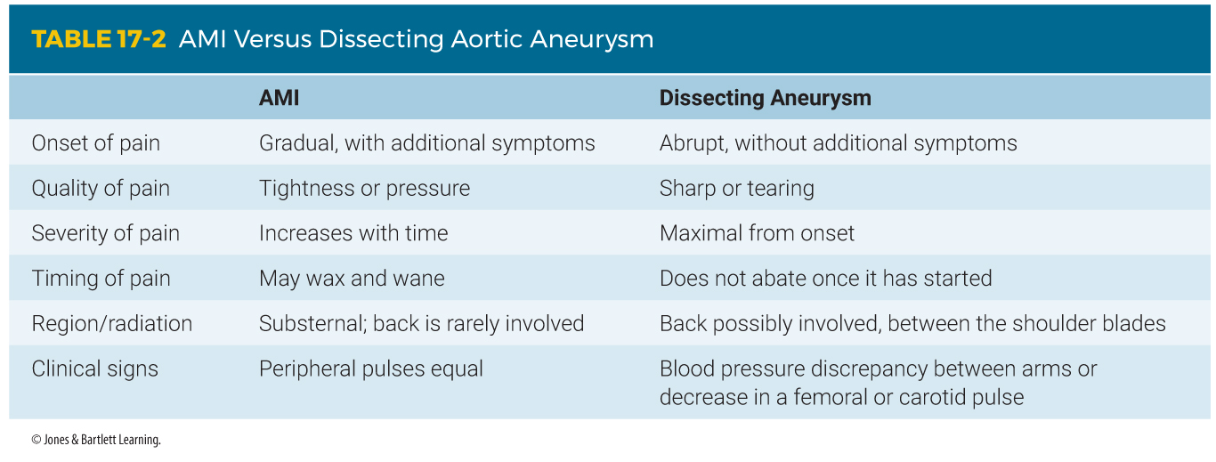
Pathophysiology (22 of 22)
Notes:
The table on this slide lists the differences in pain presentation between AMIs and aortic aneurysms.

Slide 49
Scene Size-up
Scene safety
  Ensure the scene is safe.
  Follow standard precautions.
Nature of illness (NOI)
  Obtain clues from dispatch, the scene, patient, family members, bystanders.
Notes:
Lecture Outline
IV. Patient Assessment
A. Scene size-up
1. Ensure scene safety.
2. Determine the nature of illness (NOI).
a. Use information from the dispatcher, clues at scene, and the comments of family members and bystanders.

Slide 50
Primary Assessment (1 of 2)
Form a general impression.
  If unresponsive and not breathing, begin CPR and call for AED.
Airway and breathing
  Oxygen saturation less than 95%: apply oxygen via nasal cannula at 4 L/min
  Not breathing or inadequate breathing: 100% oxygen with bag-mask device
  Pulmonary edema: bag-mask device or CPAP
Notes:
Lecture Outline
B. Primary assessment
1. Form a general impression.
a. If the patient is unresponsive and is not breathing, begin CPR, starting with chest compressions, and call for an AED.
2. Assess the patient’s airway and breathing.
a. If dizziness or fainting has occurred due to cardiac compromise, consider the possibility of a spinal injury from a fall.
b. Assess breathing to determine whether the ailing heart is receiving adequate oxygen.
i. Shortness of breath, with no signs of respiratory distress
(a) If oxygen saturation is less than 95%, administer oxygen at 4 L/min via nasal cannula.
(b) If they do not improve quickly, apply oxygen with a nonrebreathing mask at 15 L/min.
ii. Not breathing or inadequate breathing
(a) Apply 100% oxygen with a bag-mask device
iii. Pulmonary edema
(a) Positive pressure ventilation with bag-mask device or (CPAP)

Slide 51
Primary Assessment (2 of 2)
Circulation
  Check pulse, skin, capillary refill.
  Consider treatment for cardiogenic shock.
Transport decision
  Decision based on ability to stabilize life threats during primary assessment
  Transport in a stress-relieving manner.
Notes:
Lecture Outline
3. Assess the patient’s circulation.
a. Pulse rate and quality
b. Skin color, moisture, and temperature
c. Capillary refill time
d. Consider treatment for cardiogenic shock early to reduce the workload of the heart.
e. Position the patient in a comfortable position, usually sitting up and well supported.
4. Make a transport decision based on whether you were able to stabilize life threats during the primary assessment.
a. Remainder of the assessment can be performed en route, if time allows.
i. Most patients with chest pain should be transported immediately.
ii. Follow local protocol for determining what receiving facility is most appropriate.
b. Determine whether to use the lights and siren for each patient, partially based on estimated transport time.
c. As a general rule, patients with cardiac problems should be transported in the most gentle, stress-relieving manner possible.

Slide 52
History Taking (1 of 2)
Investigate the chief complaint (eg, chest pain, difficulty breathing).
Obtain a SAMPLE history from a responsive patient.
  Use OPQRST.
Notes:
Lecture Outline
C. History taking
1. Investigate the chief complaint.
a. Because patients experiencing AMI will have different signs and symptoms, seriously consider all complaints of chest pain or discomfort, shortness of breath, and dizziness.
b. If the patient is experiencing dyspnea:
i. Is it due to exertion or related to the patient’s position?
ii. Is it continuous or does it change (eg, with deep breathing)?
c. If the patient has a cough:
i. Does it produce sputum?
d. Does the patient have nausea and vomiting, fatigue, headache, and/or palpitations?
e. Ask about recent past trauma.
2. Obtain the SAMPLE history from a responsive patient.
a. Ask the following questions:
i. Have you ever had a heart attack?
ii. Have you been told that you have heart problems?
iii. Do you have any risk factors for coronary artery disease?
b. In addition, ask:
i. What allergies does the patient have?
ii. Is the patient taking medications?
3. Include the OPQRST questions when obtaining the symptoms as part of the SAMPLE history.

Slide 53
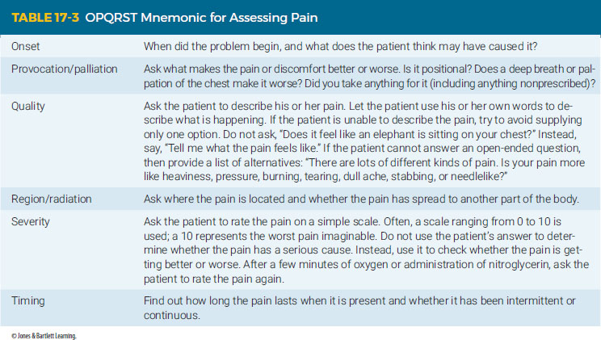
History Taking (2 of 2)
Notes:
The table on this slide displays the OPQRST mnemonic for assessing pain.

Slide 54
Secondary Assessment
Physical examination
  Focus on cardiac and respiratory systems.
    Circulation
    Respirations
Vital signs
  Measure and record the patient’s vital signs.
  If available, use pulse oximetry.
Notes:
Lecture Outline
D. Secondary assessment
1. Focus on the cardiac and respiratory systems.
a. Circulation
b. Respirations
2. Measure and record the patient’s vital signs.
a. Pulse
b. Respirations
c. Systolic and diastolic blood pressures in both arms
d. If available, use pulse oximetry.
e. If continuous blood pressure monitoring is available, use it as well.
f. Repeat at appropriate intervals and note the time that each set of vital signs is taken and recorded.
g. In patients with chest pain, it is very valuable to have a 12-lead ECG tracing from as early as possible after the onset of pain.

Slide 55
Reassessment
Reassess vital signs at least every 5 minutes or when patient’s condition changes significantly.
If cardiac arrest occurs, perform CPR immediately until an AED is available.
Reassess your interventions.
Provide rapid patient transport.
Notes:
Lecture Outline
E. Reassessment
1. Repeat the primary assessment by checking to see whether the patient’s chief complaint and condition have improved or are deteriorating.
2. Reassess vital signs at least every 5 minutes or any time significant changes in the patient’s condition occur.
3. Sudden cardiac arrest is always a risk with patients experiencing a cardiovascular emergency.
a. If cardiac arrest occurs:
i. If an AED is immediately available, use it
ii. If not, perform CPR immediately until an AED is available.
4. Reassess your interventions.
5. Provide transport if not performed already.
6. Communication and documentation
a. Alert the emergency department about the patient’s condition and estimated time of arrival.
b. Follow the instructions of medical control.
c. Document your assessment and treatment of the patient.

Slide 56
Emergency Medical Care for Chest Pain or Discomfort (1 of 6)
Ensure a proper position of comfort.
Give oxygen if indicated.
Depending on protocol, prepare to administer low-dose aspirin and assist with prescribed nitroglycerin.
Notes:
Lecture Outline
V. Emergency Medical Care for Chest Pain or Discomfort
A. Ensure a proper position of comfort.
1. Allow patients to sit up if most comfortable.
2. Loosen tight clothing.
B. Give oxygen if indicated.
1. Continually reassess oxygen saturation and patient’s respiratory status.
a. Use nasal cannula for patients with mild dyspnea.
b. Use nonrebreathing face mask for patients with more serious respiratory difficulty.
c. If signs of pulmonary edema are present, CPAP may be indicated.
d. Assist unconscious patients with breathing as well as those with obvious respiratory distress.
C. Depending on local protocol, prepare to administer low-dose aspirin and assist with prescribed nitroglycerin.

Slide 57
Emergency Medical Care for Chest Pain or Discomfort (2 of 6)
Aspirin
  Prevents blood clots from forming or getting bigger
  81 mg chewable tablets
  Recommended dose: 162 mg (two tablets) to 324 mg (four tablets)
Notes:
Lecture Outline
1. Aspirin
a. Prevents new clots from forming or new existing clots from getting bigger.
b. Recommended dose is 162 mg to 324 mg.
c. Use low-dose aspirin (81 mg).

Slide 58
Emergency Medical Care for Chest Pain or Discomfort (3 of 6)
Nitroglycerin
  Available forms
    Sublingual pill
    Sublingual spray
    Skin patch applied to chest
Notes:
Lecture Outline
2. Nitroglycerin
a. Available as a small tablet, a spray, and a skin patch.

Slide 59
Emergency Medical Care for Chest Pain or Discomfort (4 of 6)
Nitroglycerin
  Mechanism of action:
    Relaxes blood vessel walls
    Increases blood flow and oxygen supply to heart
    Decreases workload of heart
    Dilates blood vessels
Notes:
Lecture Outline
b. Mechanism of action:
i. Relaxes the muscles of blood vessel walls
ii. Dilates coronary arteries
iii. Increases blood flow and supply to the heart
iv. Decreases the workload of the heart

Slide 60
Emergency Medical Care for Chest Pain or Discomfort (5 of 6)
Nitroglycerin
  Side effects:
    Decreased blood pressure
    Severe headache
Notes:
Lecture Outline
c. Side effects:
i. Decreased blood pressure
ii. Severe headache

Slide 61
Emergency Medical Care for Chest Pain or Discomfort (6 of 6)
Nitroglycerin
  Contraindications:
    Systolic blood pressure <100 mm Hg
    Head injury
    Use of erectile dysfunction drugs within 24 hours
    Maximum prescribed dose has been given.
Notes:
Lecture Outline
d. Contraindications:
i. Systolic blood pressure is less than 100 mm Hg
ii. Presence of head injury
iii. Use of erectile dysfunction drugs within 24 to 48 hours
iv. Maximum prescribed dose has already been given (usually 3 doses)

Slide 62
Cardiac Monitoring (1 of 4)
For an ECG to be reliable and useful, electrodes must be placed in consistent positions.
Basic principles should be followed to minimize artifact in the signal.
Notes:
Lecture Outline
VI. Cardiac Monitoring
A. For an ECG to be reliable and useful, the electrodes must be placed in consistent positions on each patient.
B. Certain basic principles should be followed to achieve the best skin contact and minimize artifact in the signal.

Slide 63
Cardiac Monitoring (2 of 4)
Guiding principles:
  May need to shave body hair
  Rub electrode site with alcohol swab before application.
  Attach electrodes to ECG cables before placement.
  Confirm electrode placement.
Notes:
Lecture Outline
C. Guiding principles:
1. It may occasionally be necessary to shave body hair from the electrode site.
2. Rub the electrode site briskly with an alcohol swab before application to remove oils and dead tissues from the surface of the skin.
3. Attach the electrodes to the ECG cables before placement.
a. Confirm that the appropriate electrode now attached to the cable is placed at the correct location on the patient’s chest or limbs.

Slide 64
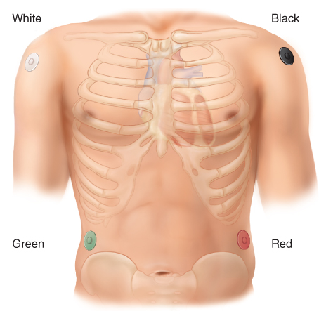
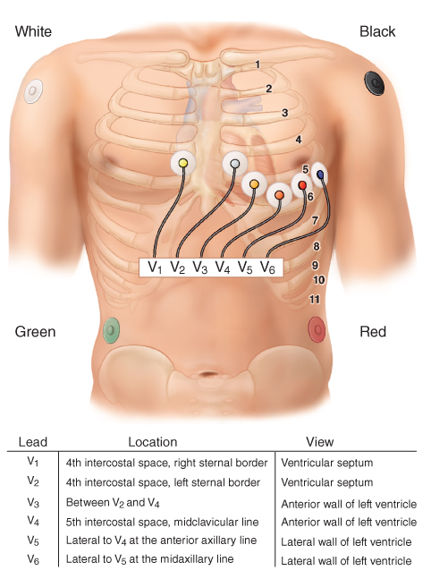
Cardiac Monitoring (3 of 4)
FIGURE 17-10 Limb electrode placement for cardiac monitoring.
FIGURE 17-11 12-lead ECG electrode placement.
© Jones & Bartlett Learning.
© Jones & Bartlett Learning.
Notes:
The figures on this slide illustrate the correct placement of ECG electrodes.

Slide 65
Cardiac Monitoring (4 of 4)
Once electrodes are in place, switch on the monitor.
  Print a sample rhythm strip.
  If strip shows artifact, confirm electrodes are firmly applied and cable is plugged in.
Notes:
Lecture Outline
4. Once all electrodes are in place, switch on the monitor.
a. Print a sample rhythm strip.
b. If the strip shows any artifact, verify that the electrodes are firmly applied to the skin and the monitor cable is plugged in correctly.
5. Follow the steps in Skill Drill 17-2.

Slide 66
Heart Surgeries and Cardiac Assistive Devices (1 of 7)
Many open-heart operations have been performed in the last 40 years.
Coronary artery bypass graft
  Chest or leg blood vessel is sewn from the aorta to a coronary artery beyond the point of obstruction.
Percutaneous transluminal coronary angioplasty
  A tiny balloon is inflated inside a narrowed coronary artery.
Notes:
Lecture Outline
VI. Heart Surgeries and Cardiac Assistive Devices
A. Over the last 40 years, hundreds of thousands of open-heart operations have been performed to bypass damaged segments of coronary arteries in the heart.
1. In a coronary artery bypass graft, a blood vessel from the chest or leg is sewn directly from the aorta to a coronary artery beyond the point of obstruction.
B. Percutaneous transluminal coronary angioplasty dilates the effected artery rather than bypassing it and involves the following steps:
1. A tiny balloon is attached to the end of a long, thin tube and introduced into a large artery.
2. The tube is threaded into the narrowed coronary artery and inflated.
3. The balloon is then deflated, and the tube and balloon are removed.
4. Sometimes a stent in placed inside the artery.

Slide 67
Heart Surgeries and Cardiac Assistive Devices (2 of 7)
Patients who have had open-heart procedures may or may not have long chest scars.
Treat chest pain in a patient who has had any of these procedures the same as a patient who has never had heart surgery.
Some patients have implanted cardiac pacemakers to maintain a regular cardiac rhythm and rate.
Notes:
Lecture Outline
C. Patients who have had a bypass procedure may or may not have a long scar on the chest.
D. Treat chest pain in a patient who has had any of these procedures in the same way you would treat chest pain in patients who have not had heart surgery.
E. Some people have cardiac pacemakers to maintain a regular cardiac rhythm and rate.

Slide 68
Heart Surgeries and Cardiac Assistive Devices (3 of 7)
Cardiac pacemakers
  Maintain regular cardiac rhythm and rate
  Deliver electrical impulse through wires in direct contact with the myocardium
  Implanted under a heavy muscle or fold of skin in the upper left portion of the chest
Notes:
Lecture Outline
1. They are inserted when the electrical system of the heart is so damaged that it cannot function properly.
2. These battery-powered devices deliver an electrical impulse through wires that are in direct contact with the myocardium.
3. The generating unit typically resembles a silver dollar and is usually placed under a heavy muscle or fold of skin in the left upper portion of the chest.

Slide 69
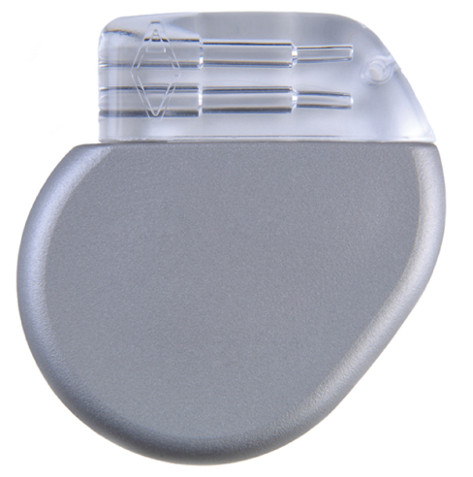
Heart Surgeries and Cardiac Assistive Devices (4 of 7)
Cardiac pacemakers (cont’d)
  This technology is very reliable.
  Pacemaker malfunction can cause syncope, dizziness, or weakness due to an excessively slow heart rate.
    Transport patients promptly.
FIGURE 17-12 A pacemaker, which is typically inserted under the skin in the left upper portion of the chest, delivers an electrical impulse to regulate the heartbeat.
© Carolina K. Smith, MD/Shutterstock.
Notes:
Lecture Outline
4. EMTs normally do not need to be concerned about problems with pacemakers.
5. When they do not function properly, pacemakers can cause a patient to experience syncope, dizziness, or weakness due to an excessively slow heart rate.
6. The pulse will ordinarily be less than 60 beats/min.
7. A patient with a malfunctioning pacemaker should be promptly transported to the emergency department.
8. When an AED is used, the patches should not be placed directly over the pacemaker.

Slide 70
Heart Surgeries and Cardiac Assistive Devices (5 of 7)
Automatic implantable cardiac defibrillators
  Used by some patients who have survived cardiac arrest due to ventricular fibrillation
  Monitor heart rhythm and shock as needed.
  Treat chest pain patients with these devices like other patients having an AMI.
  Electricity is low so it will not affect rescuers.
Notes:
Lecture Outline
F. Automatic implantable cardiac defibrillators are sometimes used by patients who have survived cardiac arrest due to ventricular fibrillation.
1. These devices continuously monitor the heart rhythm and deliver shocks as needed.
2. Treat these patients like all other patients having an AMI, including performing CPR and using an AED if the patient goes into cardiac arrest.
3. The electricity from an automatic implantable cardiac defibrillator is so low that it will have no effect on rescuers.

Slide 71
Heart Surgeries and Cardiac Assistive Devices (6 of 7)
External defibrillator vest
  A vest with built-in monitoring electrodes and defibrillation pads worn by the patient
  Attached to a monitor
  Uses high-energy shocks
    Do not touch the patient if devices warns it is about to deliver a shock.
  Vest should remain in place while CPR is being performed unless it interferes with compressions.
Notes:
Lecture Outline
G. External defibrillator vest
1. A vest with built-in monitoring electrodes and defibrillation pads, which is worn by the patient under his or her clothing.
2. The vest is attached to a monitor worn on a belt or hung from a shoulder strap.
3. This device uses high-energy shocks similar to an AED, so you should avoid contact with the patient if the device warns that it is about to deliver a shock.
4. The vest should remain in place while CPR is being performed unless it interferes with compressions.
a. If it is necessary to remove the vest, simply remove the battery from the monitor and then remove the vest.

Slide 72
Heart Surgeries and Cardiac Assistive Devices (7 of 7)
Left ventricular assist devices (LVADs)
  Used to enhance the pumping of the left ventricle
  Most common ones have an internal pump and external battery pack.
  Most patient will not have a palpable pulse.
  Transport all supplies and battery packs with the patient.
Notes:
Lecture Outline
H. Left ventricular assist devices (LVADs)
1. Used to enhance the pumping of the left ventricle in patients with severe heart failure or in patients who need a temporary boost due to an MI.
2. The most common ones have an internal pump unit and an external battery pack.
3. The pumps are almost all continuous, so most patients will not have any palpable pulse.
4. Unless the device malfunctions, you should not have to deal with it.
5. Contact medical control if there is any doubt in what to do.
6. Transport all LVAD supplies and battery packs with the patient.

Slide 73
Cardiac Arrest
The complete cessation of cardiac activity
Absence of a carotid pulse
Was terminal before CPR and external defibrillation were developed in the 1960s
High-quality CPR, early defibrillation, and access to advanced care can improve outcomes.
Notes:
Lecture Outline
VII. Cardiac Arrest
A. Cardiac arrest is the complete cessation of cardiac activity—electrical, mechanical, or both.
1. It is indicated in the field by the absence of a carotid pulse.
2. Cardiac arrest was almost always terminal until the advent of CPR and external defibrillation in the 1960s.
3. With good initial CPR, early defibrillation, and access to advanced care, it is possible for some patients to survive a cardiac arrest without neurological damage.

Slide 74
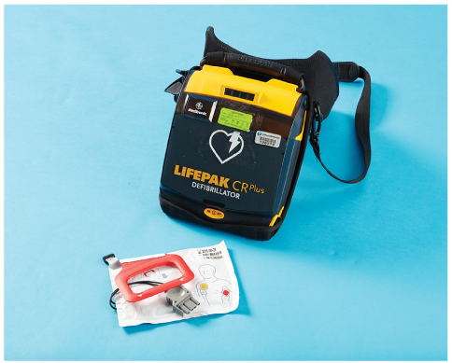
Automated External Defibrillation (1 of 11)
Analyzes electrical signals from heart
  Identifies ventricular fibrillation
  Administers shock to heart when needed
FIGURE 17-15 A. Automated external defibrillators vary in their design, features, and operation.
Jones & Bartlett Learning.
Notes:
Lecture Outline
B. Automated external defibrillation involves the use of a small computer (an automated external defibrillator [AED]) that analyzes electrical signals from the heart.
1. It identifies ventricular fibrillation and is extremely accurate.
2. It administers a shock to the heart when needed.

Slide 75
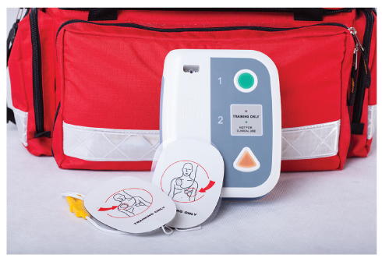
Automated External Defibrillation (2 of 11)
AED models:
  All require some operator interaction.
  Most have a computer voice synthesizer advising steps to take.
  Most are semiautomated.
FIGURE 17-15 B. Automated external defibrillators vary in their design, features, and operation.
Photographee.eu/Shutterstock.
Notes:
Lecture Outline
3. AEDs come in different models.
a. All models require some operator interaction (ie, applying the pads, turning on the machine).
b. The operator must push a button to deliver an electrical shock.
c. Many use a computer voice synthesizer to advise the EMT which steps to take.
d. Most of the AEDs are semiautomated and extremely accurate.

Slide 76
Automated External Defibrillation (3 of 11)
Advantages of AED use:
  Quick delivery of shock
  Easy to operate
  ALS providers do not need to be on scene.
  Remote, adhesive pads safe to use
  Larger pad area = more efficient shocks
Notes:
Lecture Outline
4. Advantages of AED use include the following:
a. Quick delivery of an electrical shock
b. Easy to operate
c. No need for ALS providers to be on the scene
d. Remote, adhesive defibrillator pads are safe to use
e. Larger pad area than manual paddles, which means that the transmission of electricity is more efficient

Slide 77
Automated External Defibrillation (4 of 11)
Other considerations
  Not all patients in cardiac arrest require shock.
  All patients in cardiac arrest should be analyzed with an AED.
  Asystole indicates no electrical activity.
  Pulseless electrical activity usually refers to a state of cardiac arrest that exists despite an organized electrical complex.
Notes:
Lecture Outline
5. Other considerations when using AEDs include the following:
a. Not all patients in cardiac arrest require electrical shock.
b. All patients in cardiac arrest should be analyzed with an AED; some do not have shockable rhythms.
c. Asystole (flatline) indicates that no electrical activity remains.
d. Pulseless electrical activity usually refers to a state of cardiac arrest that exists despite an organized electrical complex.

Slide 78
Automated External Defibrillation (5 of 11)
Early defibrillation
  Few cardiac arrest patients survive outside a hospital without a rapid sequence of events.
  Chain of survival:
    Early recognition and activation of EMS
    Immediate bystander CPR
    Rapid defibrillation
    Basic and advanced EMS
    ALS and postarrest care
    Recovery
Notes:
Lecture Outline
6. Early defibrillation is an essential intervention for patients experiencing cardiac arrest.
a. Few patients who experience sudden cardiac arrest outside of a hospital survive unless a rapid sequence of events takes place.
b. Links in the chain of survival include:
i. Recognition of early warning signs and immediate activation of EMS
ii. Immediate CPR with emphasis on high-quality chest compressions
iii. Rapid defibrillation
iv. Basic and advanced EMS
v. ALS and postarrest care
vi. Recovery

Slide 79
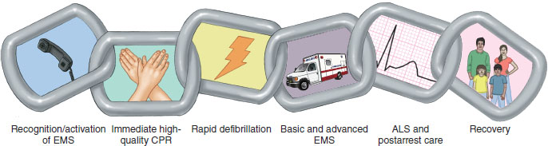
Automated External Defibrillation (6 of 11)
FIGURE 17-16 The six links of the chain of survival.
Data from American Heart Association.
Notes:
The figure on this slide illustrates the six links in the chain of survival.

Slide 80
Automated External Defibrillation (7 of 11)
Early defibrillation (cont’d)
  CPR prolongs period during which defibrillation can be effective.
  Has resuscitated patients with cardiac arrest from ventricular fibrillation
  Nontraditional first responders are being trained in AED use.
Notes:
Lecture Outline
c. CPR helps patients in cardiac arrest by prolonging the period during which defibrillation can be effective.
d. Rapid defibrillation has successfully resuscitated many patients in cardiac arrest due to ventricular fibrillation.
e. Defibrillation works best if it takes place within 2 minutes of the onset of the cardiac arrest.
f. Nontraditional first responders are being trained to use AED.

Slide 81
Automated External Defibrillation (8 of 11)
ALS and postarrest care
  Continue ventilation.
  Maintain oxygen saturation.
  Assure blood pressure >90 mm Hg.
  Targeted temperature management upon arrival to the hospital
  Advanced assessment techniques and interventions
Recovery
  May take a year or longer
Notes:
Lecture Outline
7. The fifth step in the chain of survival is ALS and postarrest care.
a. Continue ventilation at 10 breaths/min to achieve an ETCO₂ of 35 to 40 mm Hg.
b. Maintain oxygen saturation between 94% and 99%
c. Assure blood pressure is above 90 mm Hg.
d. Use of targeted temperature management when the patient arrives at the hospital.
e. Cardiopulmonary and neurologic support along with other advanced assessment techniques and interventions when indicated.
8. The final step is recovery.
a. The final step in the chain of survival, recovery can take a year or longer for many of the 10% of victims of out-of-hospital cardiac arrest who are fortunate enough to survive.

Slide 82
Automated External Defibrillation (9 of 11)
Integrating the AED and CPR
  Work the AED and CPR in sequence.
  Do not touch the patient during analysis and defibrillation.
  CPR must stop while AED performs its job.
Notes:
Lecture Outline
8. When integrating the AED and CPR into patient care, keep the following in mind:
a. It is important to work the AED and CPR in sequence.
b. Apply the AED only to pulseless, unresponsive patients.
c. Do not touch the patient while the AED is analyzing the heart rhythm and delivering shocks.
d. CPR must stop while the AED is delivering a shock.

Slide 83
Automated External Defibrillation (10 of 11)
AED maintenance
  Maintain as manufacturer recommends.
  Read the operator’s manual.
  Document AED failure.
  Check equipment daily at beginning of shift.
  Ask manufacturer for maintenance checklist.
  Report AED failures to manufacturer and US Food and Drug Administration (FDA).
Notes:
Lecture Outline
9. AED maintenance is important.
a. Become familiar with the maintenance procedures required for the brand of AED your service uses.
b. Read the operator’s manual.
c. Three most common errors in using certain AEDS:
i. Failure of the machine to shock fine V fib
ii. Applying the AED to a patient who is moving, squirming, or being transported
iii. Turning off the AED before analysis or shock is complete.
d. Operator errors include:
i. Failing to apply the AED to a patient in cardiac arrest
ii. Not pushing the analyze or shock buttons when the machine advises you to
iii. Pushing the power button instead of pushing the shock button when a shock is advised.
e. Make sure the battery is properly maintained.
f. Check your equipment, including your AED, daily at the beginning of each shift.
g. Ask the manufacturer for a checklist of items that should be checked daily, weekly, or less often.

Slide 84
Automated External Defibrillation (11 of 11)
Medical direction should approve written protocol for AED use.
Continuing education with skill competency review is generally required for EMS providers.
Notes:
Lecture Outline
h. Report any AED failure that occurs while caring for a patient to the manufacturer and to the US Food and Drug Administration.
i. Be sure to follow the appropriate EMS procedures for notifying these organizations.
10. Medical direction should approve the written protocol that you will follow in caring for patients in cardiac arrest.
a. The EMT team and your service’s medical director or quality improvement officer should review each incident in which the AED is used.
b. Quality improvement involves both the individuals using AEDs and the responsible EMS system managers.
c. Reviews should focus on speed of defibrillation (ie, the time from the call to the shock).
d. Shocks should be delivered within 1 minute of the call.
e. Mandatory continuing education with skill competency review is generally required for EMS providers.

Slide 85
Emergency Medical Care for Cardiac Arrest (1 of 7)
Preparation
  Make sure the electricity injures no one.
  Do not defibrillate patients in pooled water.
  Do not defibrillate patients touching metal.
Notes:
Lecture Outline
VII. Emergency Medical Care for Cardiac Arrest
A. When preparing to use an AED, it is the EMT’s job to make sure that the electricity from the AED injures no one.
1. Do not defibrillate patients in pooled water; electricity will diffuse through the pooled water.
a. You can defibrillate a soaking wet patient but dry the patient’s chest first.
2. Do not defibrillate patients who are touching metal that others are touching.

Slide 86
Emergency Medical Care for Cardiac Arrest (2 of 7)
Preparation (cont’d)
  Carefully remove nitroglycerin patch and wipe with dry towel before shocking.
  Shave hairy chest to increase conductivity.
  Determine the NOI and/or MOI.
Call for ALS assistance in a tiered system.
Notes:
Lecture Outline
3. Carefully remove a nitroglycerin patch from a patient’s chest and wipe the area with a dry towel before defibrillation to prevent ignition of the patch.
4. It is often helpful to shave a hairy patient’s chest before pad placement to increase conductivity.
5. Determine the patient’s NOI and/or MOI.
a. Perform spinal immobilization for trauma patients during the primary assessment.
6. Call for ALS assistance if in a tiered system with a patient in cardiac arrest.
7. Use a well-organized team approach.

Slide 87
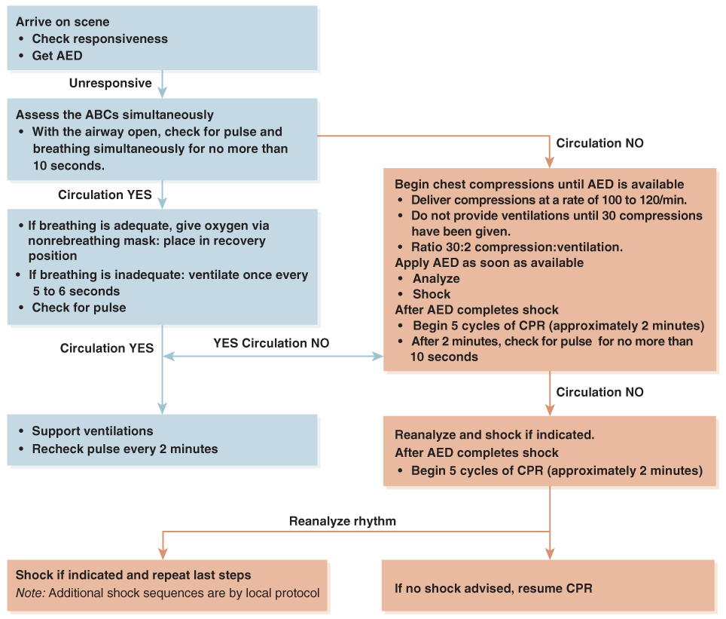
Emergency Medical Care for Cardiac Arrest (3 of 7)
FIGURE 17-18 Automated external defibrillator (AED) algorithm. CPR indicates cardiopulmonary resuscitation.
© Jones & Bartlett Learning.
Notes:
The figure on this slide displays the AED algorithm.

Slide 88
Emergency Medical Care for Cardiac Arrest (4 of 7)
Begin chest compressions and attach AED as soon as available with witnessed cardiac arrests.
Follow local protocol for patient care after AED use.
  After AED protocol is completed, one of the following is likely:
    Pulse regained
    No pulse regained and no shock advised
    No pulse regained and shock advised
Notes:
Lecture Outline
B. If you witness a patient’s cardiac arrest, begin CPR starting with chest compressions and attach the AED as soon as it is available. See Skill Drill 17-3 for the steps of using an AED.
C. Follow local protocols for patient care following AED use.
1. After the AED protocol is completed, one of the following is likely:
a. Pulse is regained (ROSC).
b. No pulse, and the AED indicates that no shock is advised.
c. No pulse, and the AED indicates that a shock is advised.

Slide 89
Emergency Medical Care for Cardiac Arrest (5 of 7)
Wait for ALS and continue shocks and CPR on scene.
If ALS is not responding and protocols agree, begin transport when:
  The patient regains a pulse.
  6 to 9 shocks are delivered.
  AED gives three consecutive messages (every 2 min of CPR) advising no shock.
Notes:
Lecture Outline
2. If ALS is responding to the scene, stay where you are and continue the sequence of shocks and CPR.
3. If ALS is not responding to the scene and protocols agree, begin transport when one of the following occurs:
a. The patient regains a pulse.
b. Six to nine shocks are delivered (or as directed by local protocol).
c. The machine gives three consecutive messages (separated by 2 minutes of CPR) that no shock is advised (or as directed by local protocol).

Slide 90
Emergency Medical Care for Cardiac Arrest (6 of 7)
Cardiac arrest during transport:
  Stop the vehicle.
  Begin CPR if AED is not immediately available
  Call for ALS support.
  Analyze rhythm.
  Deliver shock, if indicated, and resume CPR.
  Continue resuscitation per local protocol.
Notes:
Lecture Outline
D. Cardiac arrest during transport
1. If you are traveling to the hospital with an unconscious patient and the patient becomes pulseless:
a. Stop the vehicle.
b. Begin CPR if the AED is not immediately ready.
c. Call for ALS support or other available resources based on circumstances and local protocol.
d. Analyze the rhythm.
e. Deliver one shock, if indicated, and immediately resume CPR.
f. Continue resuscitation according to your local protocol.
2. If you are en route with a conscious adult patient who is having chest pain and becomes unconscious:
a. Check for a pulse.
b. Stop the vehicle.
c. Begin CPR if the AED is not immediately ready.
d. Analyze the rhythm.
e. Deliver one shock, if indicated, and immediately resume CPR.
f. Begin compressions and continue resuscitation according to your local protocol, including transporting the patient.

Slide 91
Emergency Medical Care for Cardiac Arrest (7 of 7)
Coordination with ALS personnel
  If AED available, do not wait for ALS.
  Notify ALS of cardiac arrest.
  Do not delay defibrillation.
  Follow local protocols for coordination.
Notes:
Lecture Outline
E. Coordinate with ALS personnel according to your local protocols.
1. If you have an AED available, do not wait for paramedics to arrive.
2. Notify ALS personnel as soon as possible after you recognize a cardiac arrest.
3. Do not delay defibrillation.
4. When paramedics arrive, inform them of your actions to that point and then interact with them according to your local protocols.

Slide 92
Management of Return of Spontaneous Circulation
Monitor for respirations.
Provide oxygen via bag-mask device at 10 breaths/min.
Maintain SpO₂ between 95% and 99%.
Assess blood pressure.
See if patient can follow simple commands.
Immediately begin transport if ALS is not en route per local protocol.
Notes:
Lecture Outline
F. Management of return of spontaneous circulation
1. Monitor for spontaneous respirations.
2. Provide oxygen via bag-mask device at 10 breaths/min.
3. Maintain an oxygen saturation between 95% and 99%.
4. Assess the patient’s blood pressure.
5. See if the patient can follow simple commands.
6. If ALS is not on scene or en route, immediately begin transport to the closest appropriate hospital depending on local protocol.

Slide 93
Review
All of the following are common signs and symptoms of cardiac ischemia, EXCEPT:
  headache.
  chest pressure.
  shortness of breath.
  anxiety or restlessness.

Slide 94
Review
Answer: A
Rationale: Cardiac ischemia occurs when the heart’s demand for oxygen exceeds the available supply. Common signs and symptoms of cardiac ischemia include chest pain or discomfort, shortness of breath (dyspnea), and anxiety or restlessness. Headache is not a common symptom of cardiac ischemia.

Slide 95
Review
All of the following are common signs and symptoms of cardiac ischemia, EXCEPT:
  headache.
  Rationale: Correct answer
  chest pressure.
  Rationale: Chest pressure is a definite symptom of a cardiac event.
  shortness of breath.
  Rationale: This is a response to decreased cardiac output and hypoxia.
  anxiety or restlessness.
  Rationale: This is caused by a fear of death and is a result of hypoxia, decreased cardiac output, and ischemia.

Slide 96
Review
While palpating the radial pulse of a 56-year-old man with chest pain, you note that the pulse rate is 86 beats/min and irregular. This indicates:
  pain.
  fear.
  anxiety.
  dysrhythmia.

Slide 97
Review
Answer: D
Rationale: An irregular pulse in a patient with a cardiac problem suggests dysrhythmia—an abnormality in the heart’s electrical conduction system. Patients with signs of cardiac compromise, who have an irregular pulse, must be monitored closely for cardiac arrest.

Slide 98
Review
While palpating the radial pulse of a 56-year-old man with chest pain, you note that the pulse rate is 86 beats/min and irregular. This indicates:
  pain.
  Rationale: Pain could be a result or symptom of cardiac ischemia.
  fear.
  Rationale: Fear of impending death is usually the psychological result of having chest pain.
  anxiety.
  Rationale: Anxiety is also a symptom of a cardiac event.
  dysrhythmia.
  Rationale: Correct answer

Slide 99
Review
A 56-year-old man has an acute myocardial infarction. Which of the following blood vessels became blocked and led to his condition?
  Coronary veins
  Coronary arteries
  Pulmonary veins
  Pulmonary arteries

Slide 100
Review
Answer: B
Rationale: The coronary arteries, which branch off the aorta, supply the myocardium (heart muscle) with oxygen-rich blood. Occlusion of one or more of these arteries results in a cessation of oxygenated blood beyond the area of occlusion and results in acute myocardial infarction (AMI).

Slide 101
Review
A 56-year-old man has an acute myocardial infarction. Which of the following blood vessels became blocked and led to his condition?
  Coronary veins
  Rationale: Coronary veins do not carry oxygen and would not be the direct cause of an AMI.
  Coronary arteries
  Rationale: Correct answer
  Pulmonary veins
  Rationale: Pulmonary veins are the primary blood supply to the lungs and not the heart.
  Pulmonary arteries
  Rationale: Pulmonary arteries are the route of blood return to the left atrium from the lungs. An obstruction would not cause an AMI.

Slide 102
Review
Major controllable risk factors for an AMI include:
  older age.
  family history.
  cigarette smoking.
  male sex.

Slide 103
Review
Answer: C
Rationale: Smoking is a major controllable risk factor for any cardiovascular disease.

Slide 104
Review
A major controllable risk factor for an AMI includes:
  older age.
  Rationale: This is an uncontrollable risk factor.
  family history.
  Rationale: This is an uncontrollable risk factor.
  cigarette smoking.
  Rationale: Correct answer.
  male sex.
  Rationale: This is an uncontrollable risk factor.

Slide 105
Review
A patient with cardiac arrest secondary to ventricular fibrillation has the greatest chance for survival if:
  CPR is initiated within 10 minutes.
  oxygen and rapid transport are provided.
  defibrillation is provided within 2 minutes.
  paramedics arrive at the scene within
  5 minutes.

Slide 106
Review
Answer: C
Rationale: Survival from cardiac arrest secondary to ventricular fibrillation is highest if CPR is provided immediately and defibrillation is provided within 2 minutes of the patient’s cardiac arrest. Early high-quality CPR and defibrillation are the two most important factors that influence survival from cardiac arrest.

Slide 107
Review
A patient with cardiac arrest secondary to ventricular fibrillation has the greatest chance for survival if:
  CPR is initiated within 10 minutes.
  Rationale: CPR needs to be initiated immediately.
  oxygen and rapid transport are provided.
  Rationale: Oxygen therapy and transport are important parts of resuscitation, but CPR and early defibrillation afford the greatest chance of survivability.
  defibrillation is provided within 2 minutes.
  Rationale: Correct answer
  paramedics arrive at the scene within 5 minutes.
  Rationale: Not necessarily; CPR and early defibrillation will provide the greatest chance of survivability.

Slide 108
Review
A 59-year-old woman presents with chest pressure. She is conscious and alert, but her skin is cool, pale, and clammy. Your first step in providing care (treatment) should be:
  apply the AED.
  administer oxygen.
  ask her if she takes nitroglycerin.
  take a complete set of vital signs.

Slide 109
Review
Answer: B
Rationale: Any patient with suspected cardiac compromise should be given oxygen as soon as possible. Obtaining vital signs and inquiring about the use of nitroglycerin are appropriate; however, you should administer oxygen first. The AED is only applied to patients in cardiac arrest.

Slide 110
Review
A 59-year-old woman presents with chest pressure. She is conscious and alert, but her skin is cool, pale, and clammy. Your first step in providing care (treatment) should be:
  apply the AED.
  Rationale: The AED is only applied to patients in cardiac arrest.
  administer oxygen.
  Rationale: Correct answer
  ask her if she takes nitroglycerin.
  Rationale: Inquiring about the use of nitroglycerin is appropriate, but not the first step.
  take a complete set of vital signs.
  Rationale: Obtaining vital signs is important, but not the first step.

Slide 111
Review
If a patient with an implanted pacemaker is in cardiac arrest, the EMT should:
  avoid defibrillation with the AED and transport at once.
  not apply the AED until he or she contacts medical control.
  place the AED pads away from the pacemaker.
  apply the AED pads directly over the implanted pacemaker.

Slide 112
Review
Answer: C
Rationale: The only modification required for cardiac arrest patients with an implanted pacemaker is to ensure that the AED pads are away from the pacemaker. Placing the AED pads directly over the pacemaker will result in a less effective defibrillation and may damage the pacemaker.

Slide 113
Review
If a patient with an implanted pacemaker is in cardiac arrest, the EMT should:
  avoid defibrillation with the AED and transport at once.
  Rationale: AEDs can be used with pacemakers, but avoid placing pads over pacemakers.
  not apply the AED until he or she contacts medical control.
  Rationale: EMTs are trained in the use of AEDs.
  place the AED away from the pacemaker.
  Rationale: Correct answer
  apply the AED pads directly over the implanted pacemaker.
  Rationale: AEDs should not be placed over pacemakers.

Slide 114
Review
The main advantage of the AED is:
  it provides quick delivery of a shock.
  it is easier than performing CPR.
  there is no need for ALS providers to be on scene.
  All of the above.

Slide 115
Review
Answer: D
Rationale: The AED provides quick delivery of a shock, is easier to perform than CPR, and does not require ALS providers to operate it.

Slide 116
Review
The main advantage of the AED is:
  it provides quick delivery of a shock.
  Rationale: The AED provides quick delivery of a shock.
  it is easier than performing CPR.
  Rationale: The AED is easier to perform than CPR.
  there is no need for ALS providers to be on scene.
  Rationale: ALS providers do not need to be on scene to put the AED to use.
  All of the above.
  Rationale: Correct answer.

Slide 117
Review
After administering a nitroglycerin tablet to a patient, the EMT should:
  check the expiration date of the nitroglycerin.
  reassess the patient’s blood pressure within 5 minutes.
  instruct the patient to chew the tablet until it is dissolved.
  ensure that the nitroglycerin is prescribed to the patient.

Slide 118
Review
Answer: B
Rationale: Nitroglycerin is a vasodilator and can lower the patient’s BP; therefore, you should reassess the patient’s BP within 5 minutes after giving nitroglycerin. Instruct the patient to allow the nitroglycerin to dissolve under his or her tongue; it should not be chewed. You should check the drug’s expiration date and ensure that it is prescribed to the patient before administering it.

Slide 119
Review
After administering a nitroglycerin tablet to a patient, the EMT should:
  check the expiration date of the nitroglycerin.
  Rationale: This is checked before medication administration.
  reassess the patient’s blood pressure within
  5 minutes.
  Rationale: Correct answer
  instruct the patient to chew the tablet until it is dissolved.
  Rationale: The tablet is placed under the patient’s tongue and allowed to dissolve.
  ensure that the nitroglycerin is prescribed to the patient.
  Rationale: This is checked before medication administration.

Slide 120
Review
Nitroglycerin is contraindicated in patients:
  with a systolic blood pressure less than 100 mm Hg.
  with chest pain of greater than 30 minutes duration.
  who are currently taking antibiotics for an infection.
  who are younger than 40 years of age and have diabetes.

Slide 121
Review
Answer: A
Rationale: Nitroglycerin is a vasodilator and may cause a drop in BP; therefore, it is contraindicated in patients with a systolic BP of less than 100 mm Hg and in patients who have taken erectile dysfunction (ED) drugs within the past 24 to 48 hours. ED drugs are also vasodilators; if given in combination with nitroglycerin, severe hypotension may occur.

Slide 122
Review
Nitroglycerin is contraindicated in patients:
  with a systolic blood pressure less than 100 mm Hg.
  Rationale: Correct answer
  with chest pain of greater than 30 minutes duration.
  Rationale: Cardiac chest pain is the primary indication for the use of nitroglycerin.
  who are currently taking antibiotics for an infection.
  Rationale: Antibiotics are not a contraindication for nitroglycerin use. Prior adverse reactions to the drug and the use of other nitrates would be a contraindication.
  who are younger than 40 years of age and have diabetes.
  Rationale: While the patient’s age must be considered, it is not a contraindication.

